Slide 1



IEEE Mega Project 7.0
Project : Virtual AI–Powered Health Assistant
Theme : Health care Technology
PS Category : Software
Team Name : Baymax
Git-Hub link: https://github.com/kunalsanga/AI-Health-Assitant-Web

Slide 2

Team Baymax
MEMBER 1
Name : Kunal Sanga
Year of Study: 2023-2027
College : SIT Sambalpur
Degree : B.Tech CSE
MEMBER 2
Name : Soumili Ghosh
Year of Study: 2023-2027
College : SIT Sambalpur
Degree : B.Tech CSE

Slide 3

IEEE Mega Project 7.0
Virtual AI–Powered Health Website
Problem : In today’s fast-paced world, accessing timely medical advice can be challenging due to the scarcity of immediate healthcare professionals and rising medical costs. Many people struggle to identify appropriate solutions to common health issues without professional intervention, leading to delayed care or self-diagnosis errors.
Solution: We developed a Virtual AI Health Website that provides personalized health advice and prescriptions for common medical issues. Using AI, the platform analyzes user symptoms and generates accurate, reliable recommendations tailored to their needs. Additionally, the platform integrates with smart devices such as smartwatches and health trackers to monitor health metrics like heart rate, sleep patterns, and step counts. This data enhances the AI chatbot’s ability to provide personalized and precise health recommendations, ensuring better overall care.

Slide 4
IEEE Mega Project 7.0
Technology Stack Used
Frontend:
HTML: Structuring the website content and layout.
CSS: Designing a user-friendly and visually appealing interface.
JavaScript: Adding interactivity and dynamic features, including form validation and prescription logic.
AI Integration:
Predefined rule-based algorithms and decision trees for symptom analysis.
Future scope: Integration with AI/ML frameworks for advanced diagnostics.
Device Integration:
API connections for smartwatches and health trackers to gather real-time health metrics.
Backend:
JavaScript (Node.js): To process user inputs and implement health logic.
Database:
JSON/LocalStorage: Storing predefined prescription data and user health metrics.
Tools:
Code Editor: Visual Studio Code.
Version Control: Git and GitHub for collaborative development and version management.

Slide 5
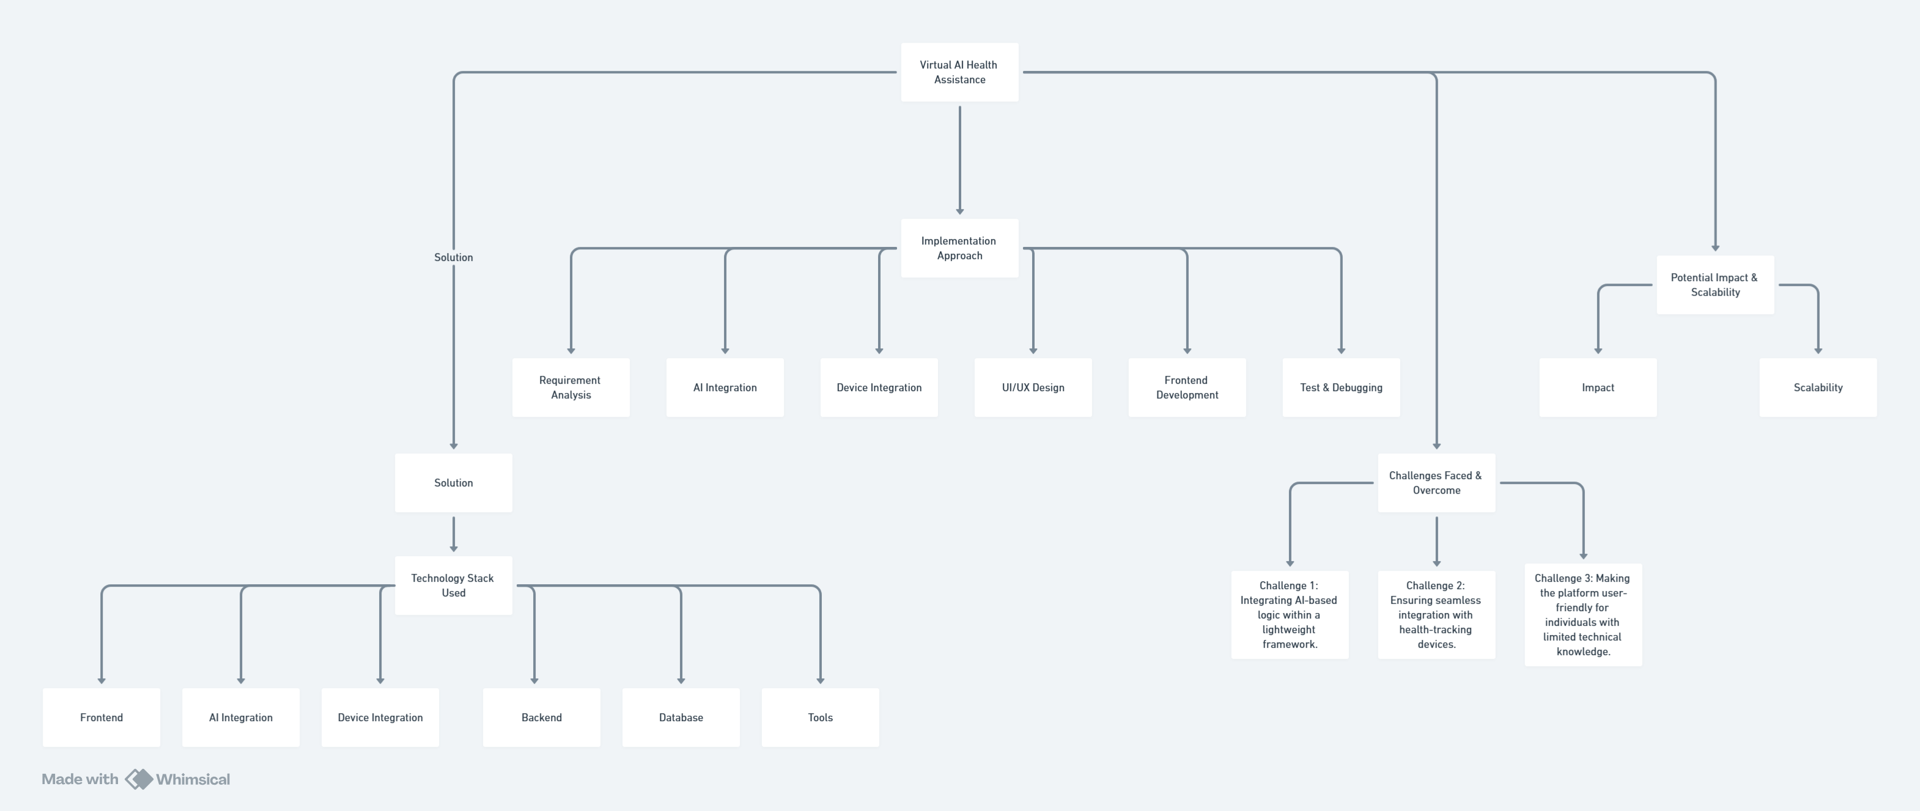
IEEE Mega Project 7.0
Flow Chart

Slide 6
IEEE Mega Project 7.0
Implementation Approach
Requirement Analysis:
Conducted research to identify common health issues and their appropriate solutions.
Explored APIs and SDKs for integrating health-tracking devices.
AI Integration:
Designed and implemented a basic AI-based rule engine for generating prescriptions.
Enhanced personalization by leveraging real-time health data from connected devices.
Device Integration:
Established secure API connections with wearable devices to collect and analyze metrics such as heart rate, sleep patterns, and step counts.
UI/UX Design:
Created a simple, intuitive, and visually appealing interface to cater to all age groups.
Added features to visualize health data from connected devices in an easy-to-understand format.
Frontend Development:
Ensured responsive web design for compatibility across devices.
Developed interactive forms for symptom input with real-time validations.
Testing and Debugging:
Performed extensive testing to ensure accuracy, functionality, and bug-free performance.
Tested compatibility with various wearable devices and platforms.

Slide 7
IEEE Mega Project 7.0
Challenges Faced and Overcome
Challenge:
Integrating AI-based logic within a lightweight framework.
Solution:
Utilized efficient algorithms and decision trees to mimic AI behavior without significant resource overhead.
Challenge:
Ensuring seamless integration with health-tracking devices.
Solution:
Researched and implemented device APIs with secure and efficient data exchange protocols.
Challenge:
Making the platform user-friendly for individuals with limited technical knowledge.
Solution:
Employed clean design principles and incorporated tooltips, guides, and a step-by-step workflow for seamless navigation.

Slide 8
IEEE Mega Project 7.0
Potential Impact and Scalability
Impact:
Provides quick and accurate health advice to users, reducing dependency on healthcare professionals for minor issues.
Enhances health literacy and empowers individuals to manage their well-being effectively.
Tracks real-time health metrics for better personalized care.
Scalability:
Advanced AI/ML integration for dynamic symptom analysis and predictive diagnostics.
Collaboration with healthcare professionals for continuous updates and validation of health recommendations.
Multilingual support to reach a diverse global audience.
Transition to mobile applications for wider accessibility and convenience.
Real-time chatbots and virtual consultations with AI-driven insights.
Expansion of device compatibility to include a broader range of health trackers and smartwatches.

